Slide 1

Paradox
Notes:
Good morning,everybody.i am xubb, a phd student from institue of computing technology. Today, I’d like to introduce paradox.

Slide 2
Contents
1
What is paradox
2
Some famous paradoxes
3
Significance of paradox
Notes:
I’ll divide it into three subtopics . Firstly what’s paradox, then focus on two famous paradoxes, and lastly, the significance of paradox.

Slide 3
What’s Paradox
A statement which is hard to judge right or wrong(悖论).
S :Men that can not cut for themselves
Barber paradox: I only cut hair for all the people who can‘t cut hair by himself.
Notes:
Ok , so ,what is paradox ,wekipedia give an explanation . Something very difficult to judge it’s wrong or right. Let me give you an example, BARBER paradox.

Slide 4

What’s Paradox
Barber can not cut hair for himself
Barber ∉ S
So Barber can cut hair for all the person belongs to S
Barber ∈ S
Notes:
So shoule the barber cut hair for himself.if he cann’t cut hair for himself.so he belongs to s .so he should cut hair for himself ,then ,he doesn’t belong to s it’s very hard to judge it ,so it’s a famous paradox.

Slide 5
Achilles paradox
V_achilles = 10 V_tortoise
At beginning:
Distance_a.t = 10km
After time T:
Distance_a.t = 1km
After time T+1/10T:
Distance_a.t = 1/10km
………
Is the tortoise always in front of Achilles? Why?
Notes:
Ok now let me give you some famous paradoxes. It is not the same as last one.firstly, achilles paradox,the speed of a is ten times of the torise. At the beginning , t is ten km in front of a. After time t,A runs 10 km,while the t runs 1 kms ,so the distance between a and t is 1 km, so is the tortoise always in front of a,Abosulutely no,but why?

Slide 6
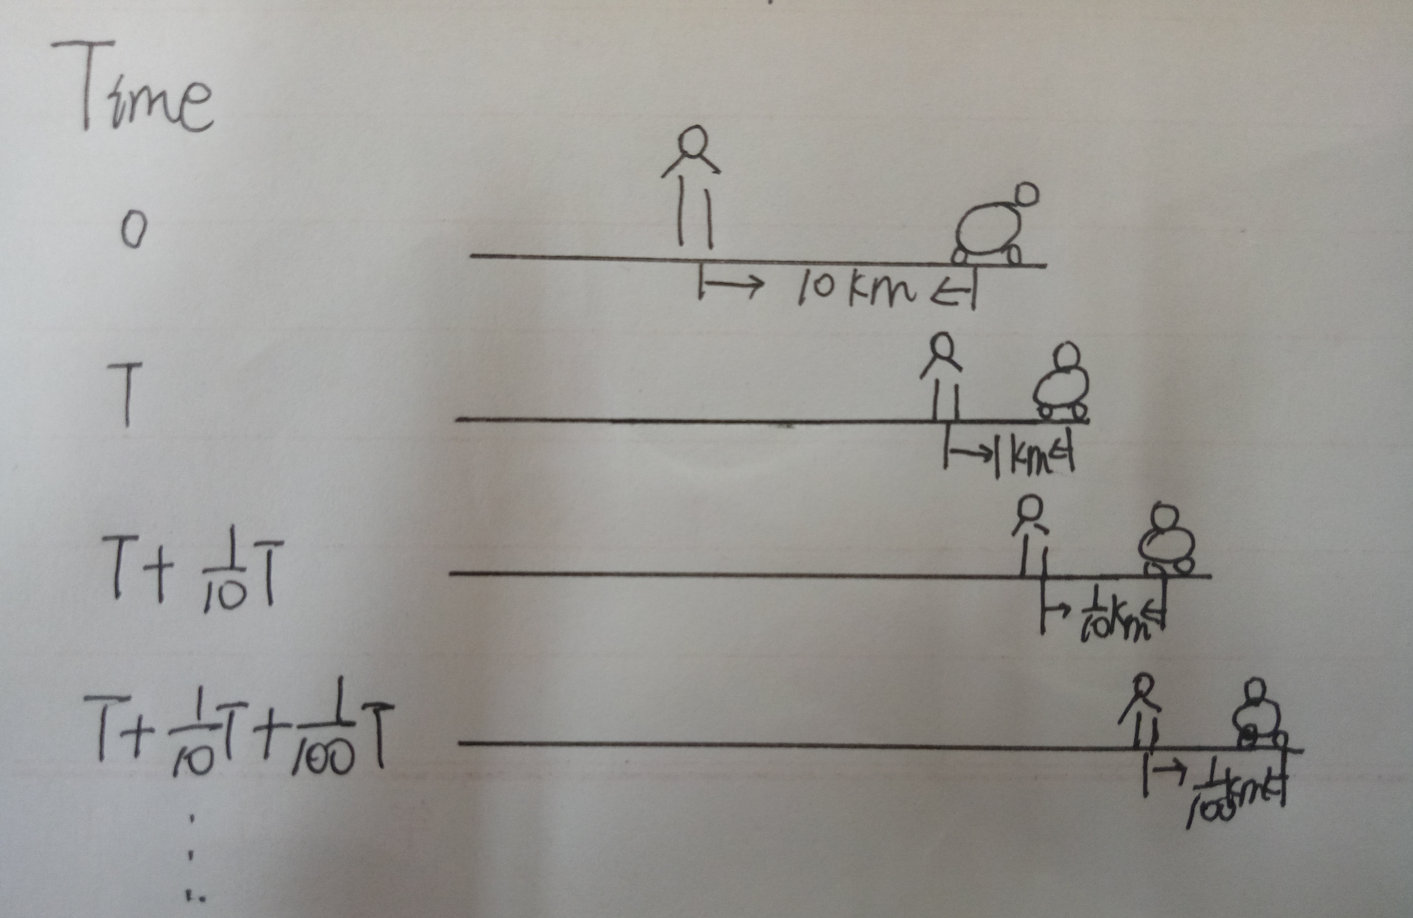
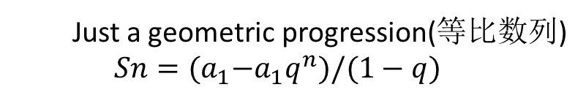
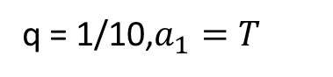
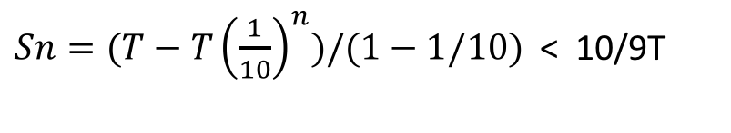
Achilles paradox
T+1/10T+1/100T+… =? Is it very big?
No
Just a geometric progression(等比数列)
$Sn={(a}_{1}−a_{1}q^{n})/(1−q)$
q = 1/10,$a_{1}=T$
So Achilles can catch up with tortoise at time 10/9T
$Sn=(T−T{\left(\frac{1}{10}\right)}^{n})/(1−1/10)$ < 10/9T
Notes:
Let me ask you a question, is T + 1/10T +1/100T +so on is very big, no just a geometric progression.we can use the summation formula to get the result, 10/9 T,so a

Slide 7
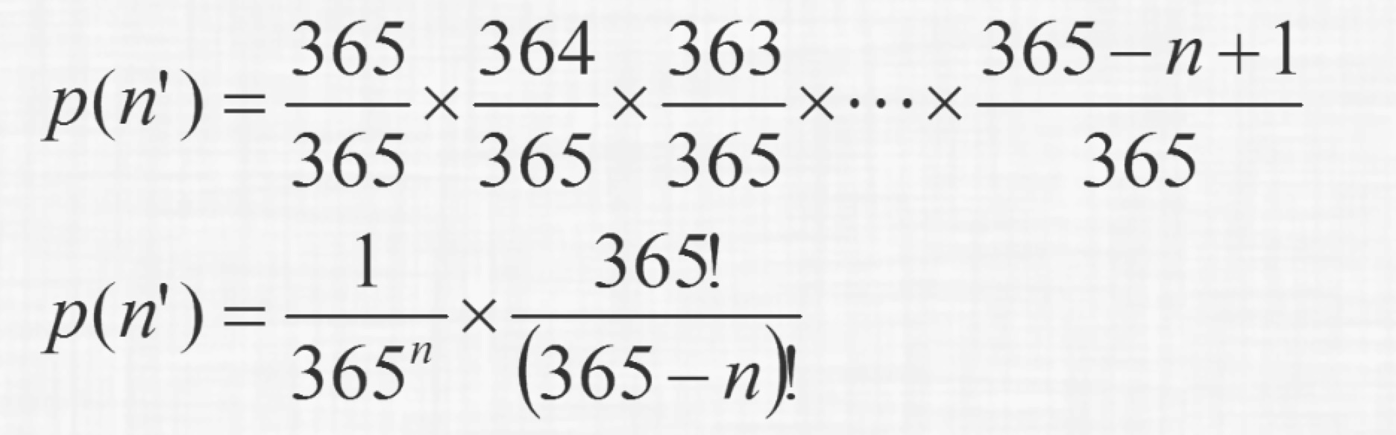
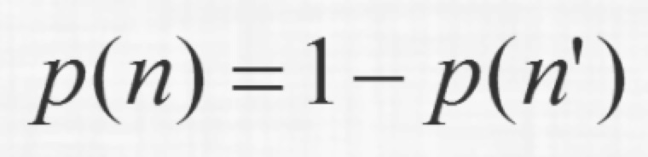
Birthday paradox
If I say there are two people in our class have the same birthday, do you believe me?
The probability of no one in n people has same birthday:
The probability of at least two in n people has same birthday:
Notes:
Another famous paradox is birthday paradox,if …,ok let’s check it. p(n dot) defines the probability of .so the denominator is n power of 365,and the numerator is like this. So the pro… is 1 minus p n dot.

Slide 8
Birthday paradox
The probability of two people in our class have the same birthday: about 80%.
Notes:
This chart gave a result of birthday paradox. If there are 23 people, the pro of a pair is more than 50%,so the pro of ...

Slide 9
Significance of Paradox
Notes:
Lastly , the significance of paradox.

Slide 10

Significance of Paradox
Promoting the development of mathematics and physics
Calculus(微积分)
More completed theory of sets
Notes:
Paradox promotes the … A is the fountain of calculus. a more completed theory of sets is given because of barber paradox.

Slide 11
Significance of Paradox
Train the ability of thinking and rethinking, enable us to further comprehend the world.
Notes:
Also, it can …

Slide 12
Thanks for listening
Q&A
Notes:
Ok ,that’all . Thanks for learning , any qiestions?

